Slide 1
Traffic Accidents in College Station & Bryan
Alan Mendoza
alan_mendoza34@tamu.edu

Slide 2
Potential Customers
College Station Police Department
-Stormy R. Potter, the Public Safety GIS Analyst
EMS Agencies
-Coordinators or Director Program

Slide 3
Introduction
Objective: Map the locations of traffic accidents to see if there is a solution/correlation to better EMS response at peak times.
Questions I wanted to answer.
Where and when do most vehicular accidents occur in the College Station area?
Is there a correlation between traffic accidents and proximity to bars or other alcohol-serving locations?

Slide 4
Introduction (cont.)
Hypothesis: Most accidents are bound to occur on the roads directly bordering campus like the Northgate area due to high levels of alcohol consumption.
Why I chose this project?
- By having access to this data, students can take precautions in high risk areas during high risk times.
- I hope that the College Station Police Department can use this data to better understand traffic flow within the city to patrol the area more closely.
- Personal curiosity

Slide 5
Motivation
National Average of Response time is 8 minutes.
Critical Treatment: CPR
For every minute without CPR you have already lost 10% of survival rate.
Agencies & Cities already have applications but they are not shared with the public.

Slide 6
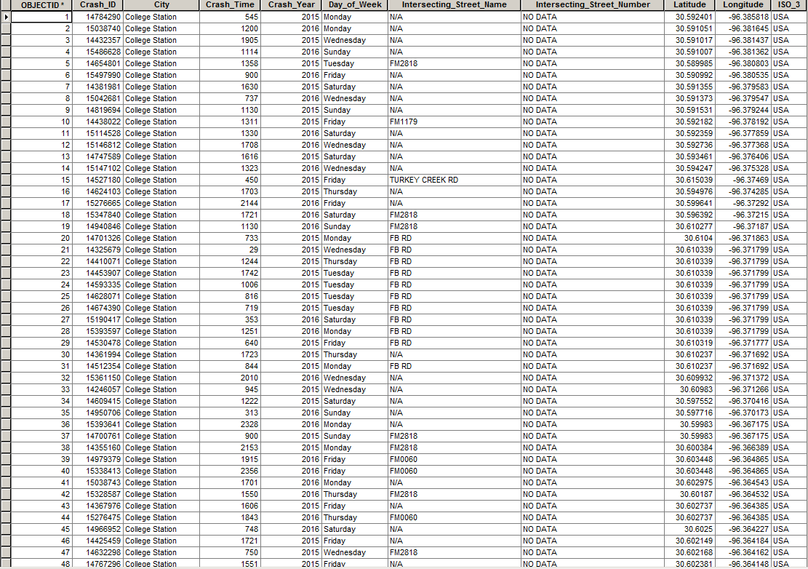
Methods/Results
Obtained the data from Stormy R. Potter, the Public Safety GIS Analyst of College Station Police Department
Data obtained was in this format

Slide 7
Methods/Results Con’t
Received 3,364 crashes within 2 years ( January 2015-December 2016 )
Monday = 465 crashes
Tuesday = 472 crashes
Wednesday = 521 crashes
Thursday = 470 crashes
Friday = 631 crashes
Saturday = 477 crashes
Sunday = 328 crashes
Average = 32.346 crashes per week within the 2 years.

Slide 8
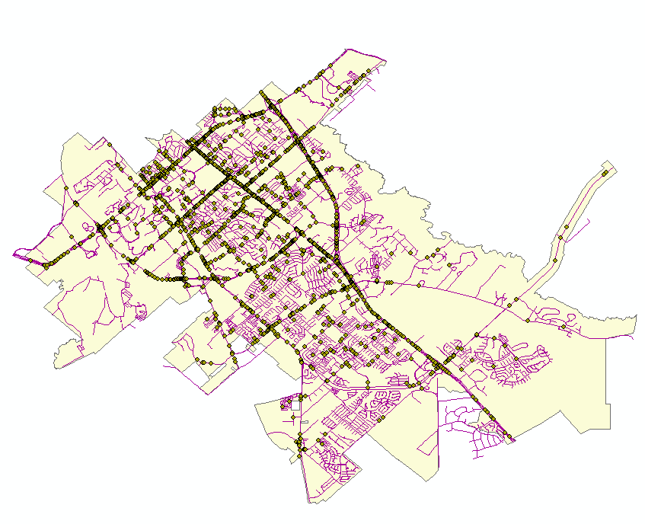
Map
-Plotted the data after creating a geodatabase with the received data
- The data was then divided into 7 categories, based on the days of the week.

Slide 9
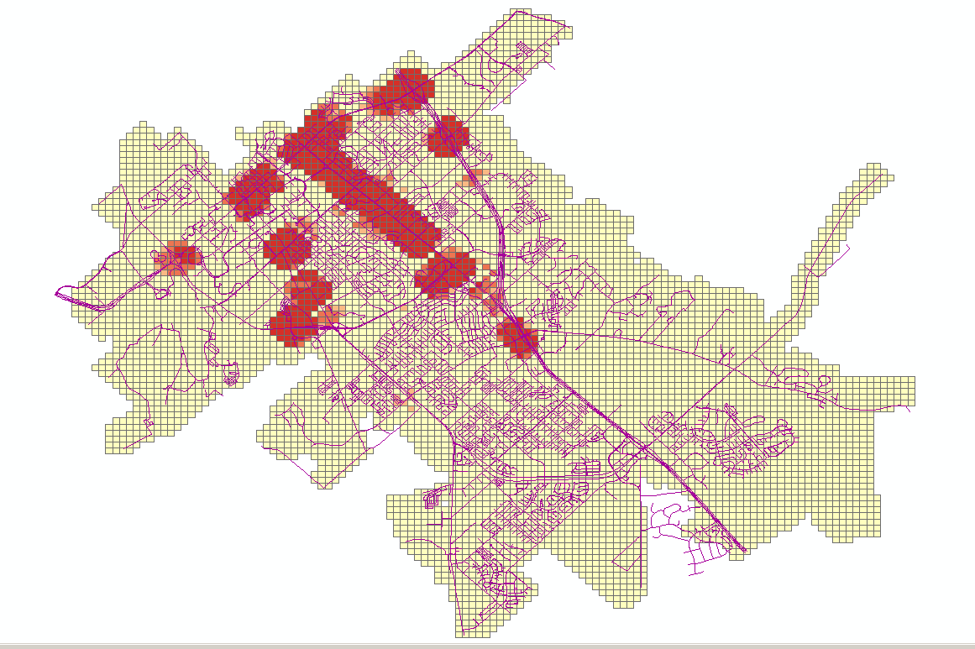
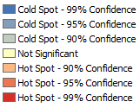
Applied the Optimized Hotspot Analysis from ArcMap to gain the hotspot data

Slide 10
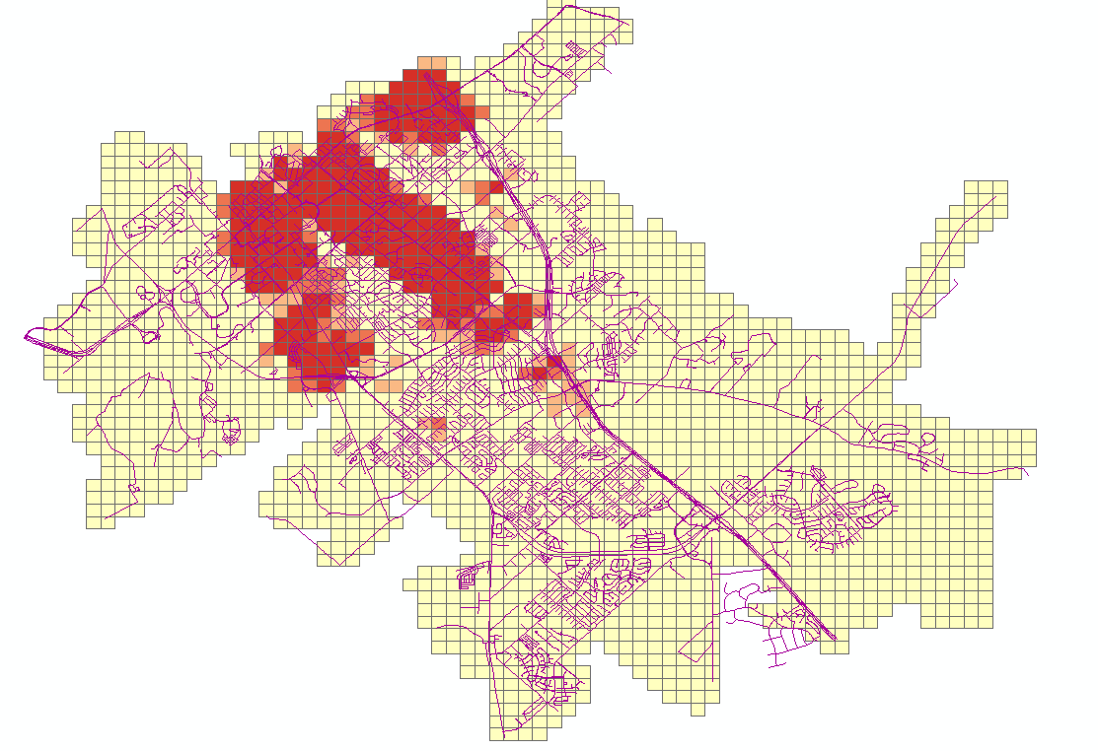
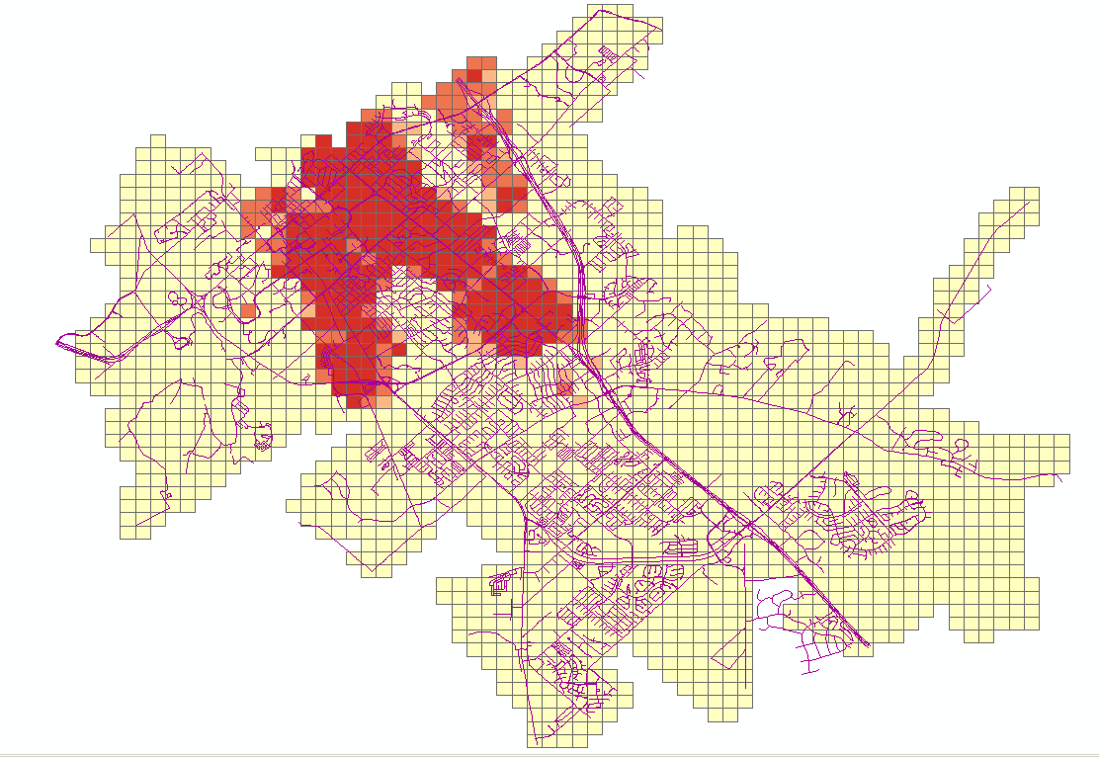
Monday
Tuesday

Slide 11
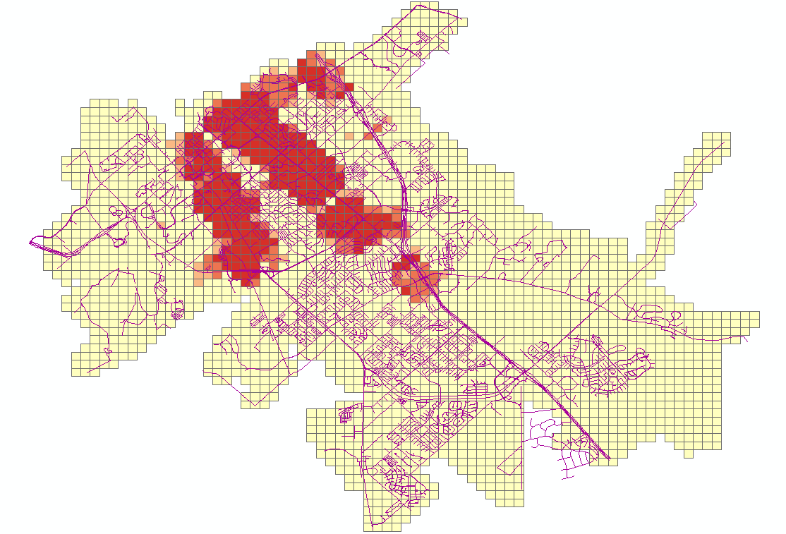
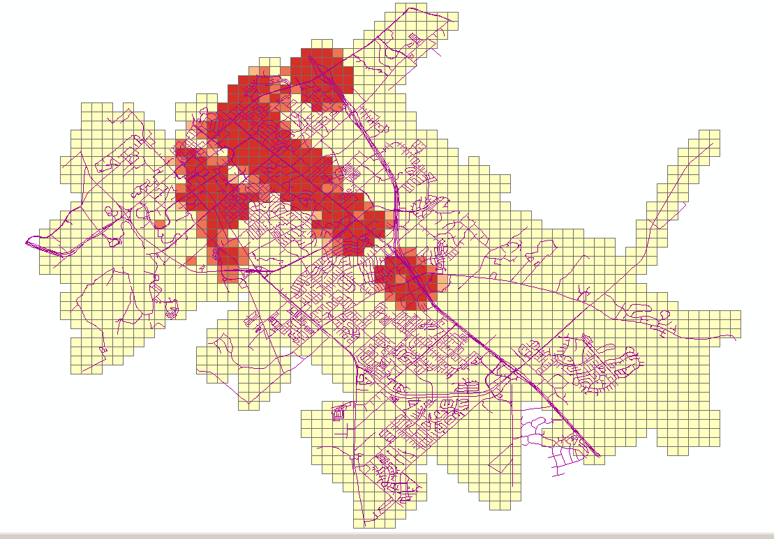
Wednesday
Thursday

Slide 12
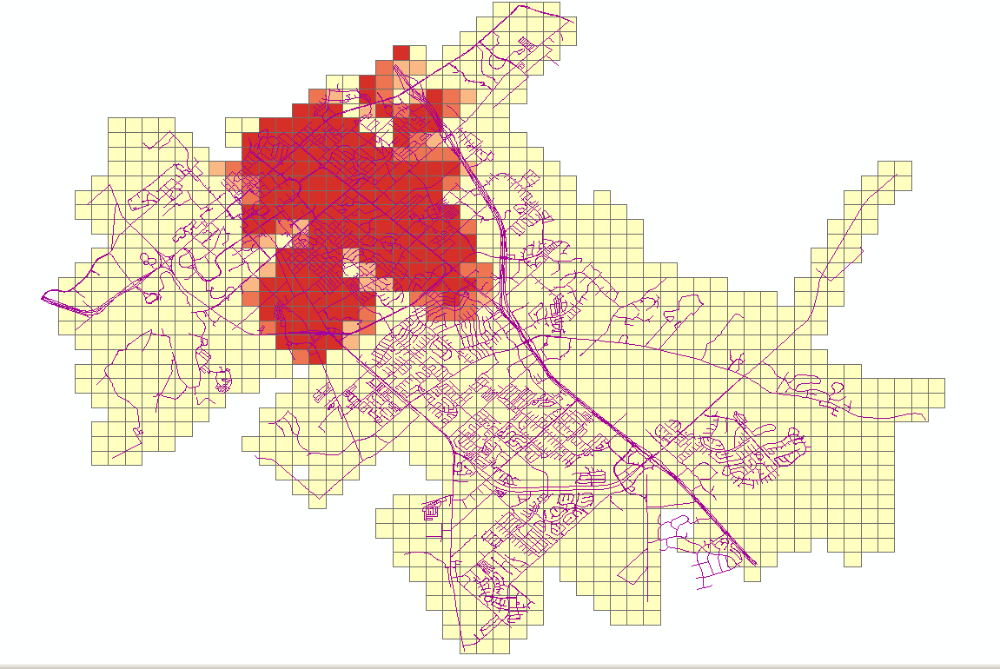
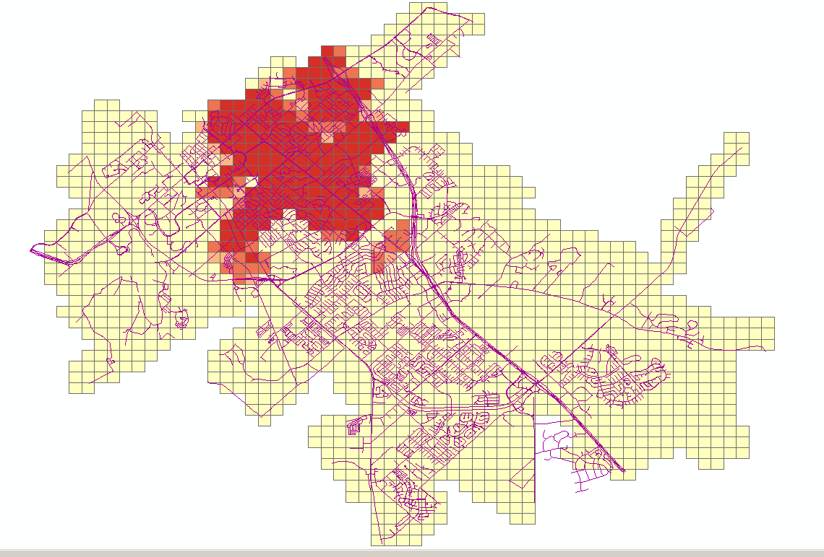
Friday
Saturday

Slide 13
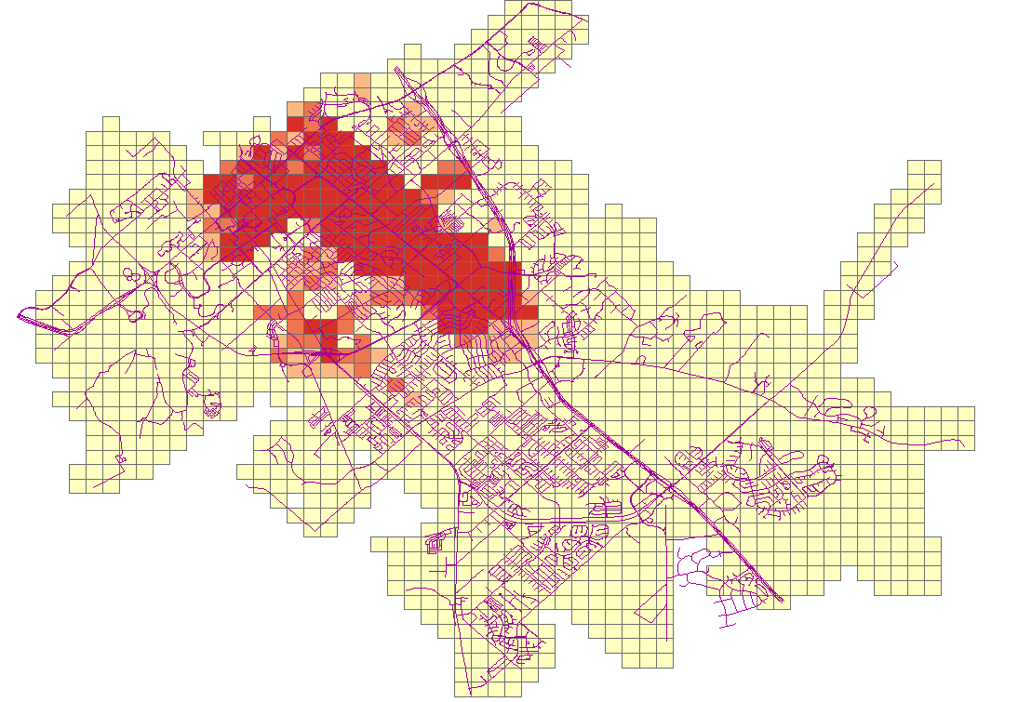
Sunday

Slide 14
Web Map
https://fusiontables.googleusercontent.com/embedviz?q=select+col7+from+1oMx2qjUtN8S3-1hLmDRx6uzFlOENsZlSFdin_iug&viz=MAP&h=false&lat=30.61078645700353&lng=-96.3352386152539&t=1&z=13&l=col7&y=2&tmplt=2&hml=TWO_COL_LAT_LNG
https://fusiontables.googleusercontent.com/embedviz?q=select+col7,+col8+from+1oMx2qjUtN8S3-1hLmDRx6uzFlOENsZlSFdin_iug+limit+1000&viz=HEATMAP&h=true&lat=30.61078645700353&lng=-96.3352386152539&t=1&z=13&l=col7&y=2&tmplt=2&hmd=true&hmg=%2366ff0000,%2393ff00ff,%23c1ff00ff,%23eeff00ff,%23f4e300ff,%23f4e300ff,%23f9c600ff,%23ffaa00ff,%23ff7100ff,%23ff3900ff,%23ff0000ff&hmo=0.6&hmr=21&hmw=0&hml=TWO_COL_LAT_LNG

Slide 15
Results
Overall the crash hotspot for each of the days of week were similar from one and another, except the few which are Friday and Wednesday
Most of the crashes occur in the intersection between Texas and University, with having some spill over from those intersection.
Most accidents happen during day with good conditions at major intersections.

Slide 16
Results
Overall throughout the week the area with the most crashes occur are at S. Texas Ave. and it’s intersecting roads, Northgate area, and the intersection between Frontage Rd. and University Dr.

Slide 17
Conclusion
After creating each map for everyday of the week I came to the conclusion that Friday and Wednesday are the days with more traffic accidents in the College Station area. Also found a high correlation between the area and accidents. Our hypothesis was correct in the sense that the higher frequency of accidents occurred around the Northgate district.

